Slide 1


Introduction
In today’s data driven world, predictive analytics has become a key tool for businesses to drive growth.
The BigMart Sales Prediction Mini Project utilizes various ML Algorithms to forecast future sales trends and help businesses make informed decisions.
Predictive analytics uses past data and statistical algorithms to make accurate predictions about future trends and events.
By analyzing data such as consumer behaviour, sales patterns, and market trends, businesses can improve decision making and gain a competitive edge.
For continuous variables, the accuracy measures Root Mean Square Error (RMSE) and Mean Absolute Error (MAE) are used to evaluate model performance.
This Photo by Unknown Author is licensed under CC BY-SA
This Photo by Unknown Author is licensed under CC BY-SA

Slide 2



Identifying the Problem Understanding the challenges in BigMart Sales Prediction
Lack of accurate sales forecasting
Sales forecasting is crucial for business planning and decision-making
Inefficient data analysis methods
Current methods are time-consuming and prone to errors
Limited insights into customer behavior
Understanding customer behavior can drive sales growth

Slide 3
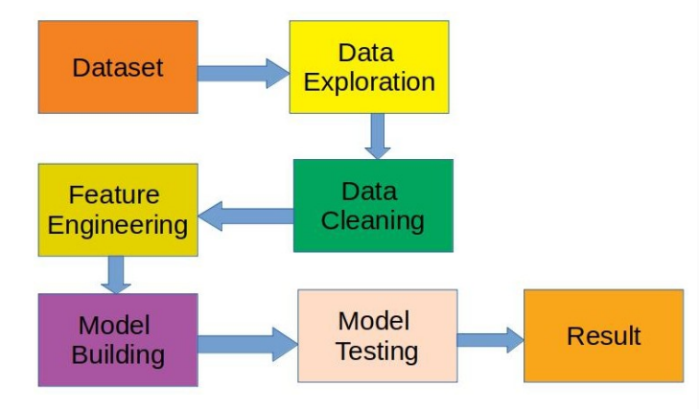
Methodology
Hypothesis Generation – understanding the problem better by brainstorming possible factors that can impact the outcome
Data Pre-processing
Data Exploration – looking at categorical and continuous
feature summaries and making inferences about the data.
Data Cleaning – imputing missing values in the data and checking for outliers
Feature Engineering – modifying existing variables and creating new ones for analysis
Model Building – making predictive models on the data
EDA- It is one of the most important parts when it comes to data analysis.To gain important insights of our data, one must do exploratory data analysis. Here in our project we used two libraries i.e. KLib and DTale library.

Slide 4
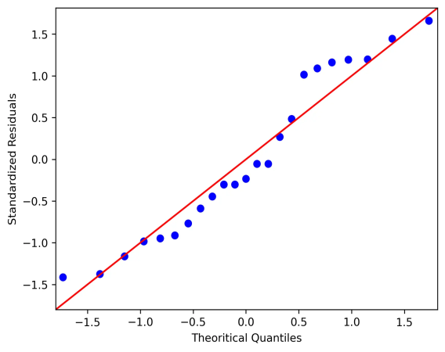
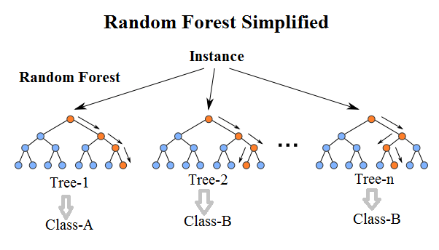
Machine Learning Algorithms Used
1. Linear Regression
Linear Regression is a machine learning algorithm based on supervised learning. It
performs a regression task. Regression models a target prediction value based on
independent variables.
2. Random Forest Regression
Random Forest is a tree-based bootstrapping algorithm based on that tree that includes
a certain number of decision trees to build a powerful predictive model.
The final prediction may be the function of all predictions made by each learner.
This Photo by Unknown Author is licensed under CC BY
This Photo by Unknown Author is licensed under CC BY

Slide 5
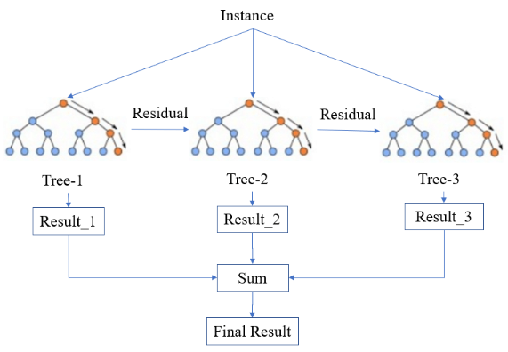
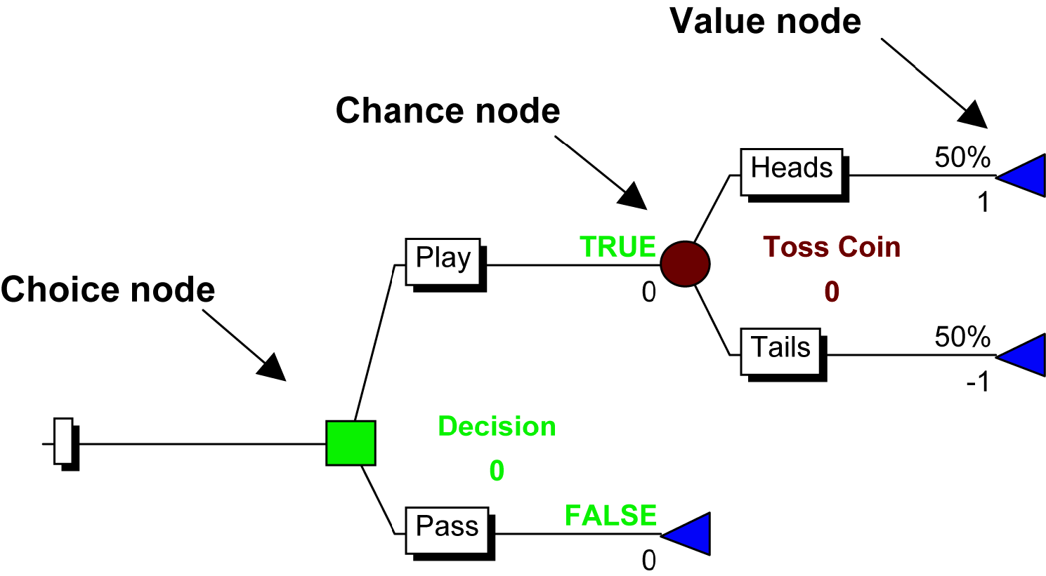
3. XGBoost Regression
XGBoost stands for eXtreme Gradient Boosting. The implementation of an algorithm
designed for the efficient operation of computer time and memory resources. Boosting
is a sequential process based on the principle of the ensemble.
4 . Decision Tree
It's a simple model with little bias that may be used to create a classifier model.
The root node is the first to be considered in a top-down approach. It is a potent
approach for data mining and a powerful method of multi-variable analysis.
This Photo by Unknown Author is licensed under CC BY-SA

Slide 6
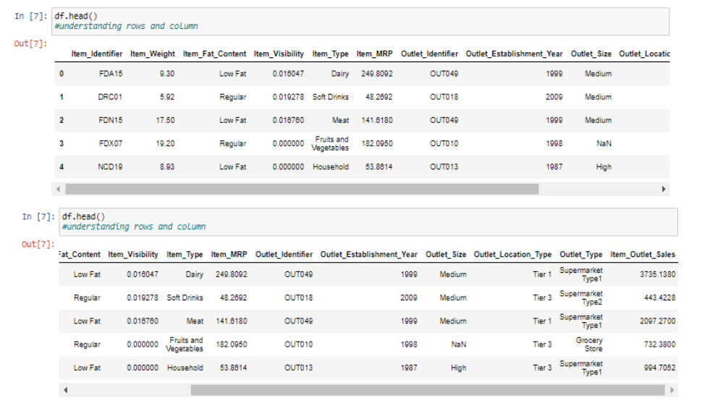
Result and Discussion
We employ a combination of time series analysis, regression analysis, and machine learning algorithms to forecast sales. These techniques enable us to capture trends, patterns, and seasonality in the sales data.
Sales Prediction Accuracy Improved
Through predictive analytics, Big Mart Sales project was able to significantly improve its accuracy in forecasting future sales.
Consumer Behaviour Insights
Data collected and analyzed from project also provided valuable insights into consumer behaviour and preferences,allowing for better decision making and targeted marketing strategies.

Slide 7

Result and Discussion
Most efficient algorithm to predict the sales revenue of Big Mart is observed with Gradient Boosted Decision Tree and Random Forest algorithms having the least RMSE value among other algorithms but with low level of accuracy.
Accuracy is critical in prediction-based systems, and it can improve dramatically as the number of parameters increases.
Stakeholders involved in sales information can provide more inputs to facilitate with hypothesis generation, and taking into account more instances can lead to more precise outcomes that closely reflect real-world scenarios.
Regression results are more expressive and well bounded, with some degree of accuracy, making them easier to interpret. The proposed approach is flexible, and it can be improved further by incorporating variants during the regression model-building stage.

Slide 8

Conclusion
Accurate sales forecasting through data analytics empowers BigMart to make informed decisions, optimize operations, and stay competitive in the market. By leveraging historical sales data and advanced analytics techniques, we can predict future sales with high accuracy, leading to improved profitability and customer satisfaction.
Upon analyzing the data, it was found that the XGBoost algorithm provided more
efficient and accurate predictions with faster results. This was evident from lower
RMSE, MSE, and MAE ratings and higher R2, Adjusted R-squared, and R-squared
values for XGBoost compared to Linear Regression.
Future Work
The potential future extension of this technology includes collaboration with other
devices endowed with built-in intelligence via the Internet of Things (IoT), making it
more feasible and versatile in its applications. Experts have stressed the importance of a smart sales projection tool for business organizations to properly manage large volumes of data.

